Slide 1
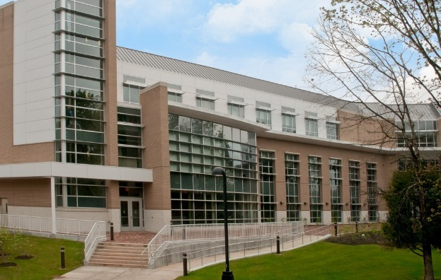
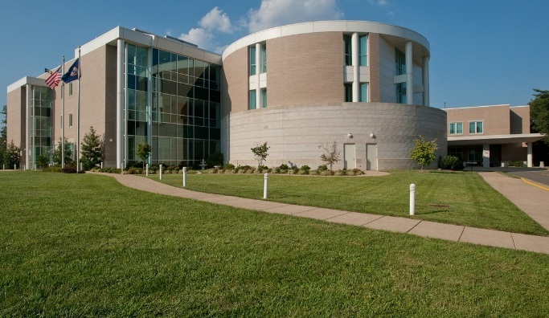
NORTHERN VIRGINIA COMMUNITY COLLEGE
OFFICE OF EMERGENCY MANAGEMENT AND SAFETY
The FEMA Disaster Grant Program (Stafford Act) for State Agencies and Colleges
“What you need to know”
March 2017

Slide 2
Thomas Mayhew, BS, PEM, CHPP
Director of Emergency Management & Safety, NVCC
Former Disaster Assistance Employee with FEMA
Project Specialist (PS)
Public Assistance Coordinator (PAC)
Task Force Lead (TFL)
Assistant State Public Assistance Officer (APAO)
Specialization in Public Safety and Institutions of Higher Education in disaster recovery.

Slide 3
Assignments to several colleges for disaster recovery….
Louisiana State University (LSU) - Katrina, Gustav, Ike
Louisiana Technical University (LA Tech) - Katrina, Gustav, Ike
Southern University (SU) - Katrina, Gustav, Ike
Iowa State University (ISU) - Flooding
University of Mary Washington (UMW) - Earthquake
Southern Maryland Community College – Snow

Slide 4
Session Topics
Quick overview
Is it worth my time?
Is the return worth the investment?
What information will I need?
Successfully navigating the process

Slide 5
Quick Overview of Public Assistance
Public Assistance is for public entities (and some non-governmental entities), not individuals.
The Commonwealth is the grantee or applicant from FEMA. The Commonwealth is held responsible for every cent of FEMA money awarded during the process cycle.
The Agency (such as yourself) are considered sub-grantee or sub-applicant to the Commonwealth.

Slide 6
Is it worth my time?
The short answer is yes!
With a bit of initial planning before the incident, you can make the process of FEMA funding worth your while!
The investment in preparation is well worth the results when a disaster strikes!

Slide 7
Most times, you can recoup 75% of your investment
in recovery!
Depending on the Commonwealth match, you could recover as much as 90% of your costs! (disaster specific)
Even your time working on the grant process is chargeable to the project! (project specific)

Slide 8
What do I need?
Let’s look at a list of some of the things you’ll need for the application process…..

Slide 9
Labor Records (Force Account Labor)
Employee Timecards
Employee Costs
Employee Benefit Rate
Employee Compensation Evidence (pay documents)
Employee Pay Policies
Job Assignments During the Disaster

Slide 10
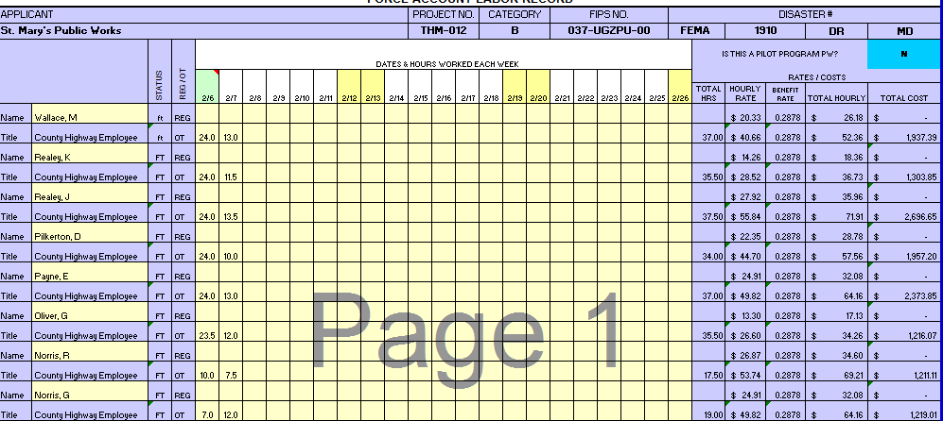
Typical Employee Tracking

Slide 11
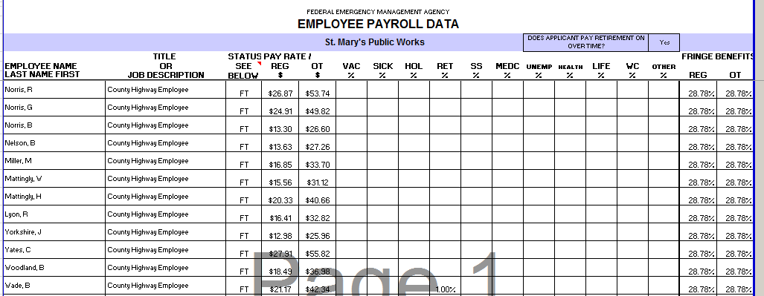
Employee Payroll Data

Slide 12
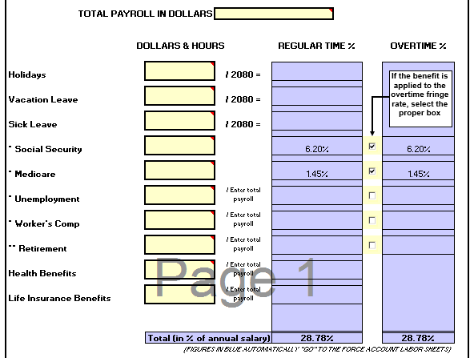
Employee Fringe Summary

Slide 13
Equipment records (Force Account Equipment)
Equipment used during event - hours of operation
Who operated it? – equipment use is referenced with employee hours
Hourly allowance, wear and tear, breakage/failure

Slide 14
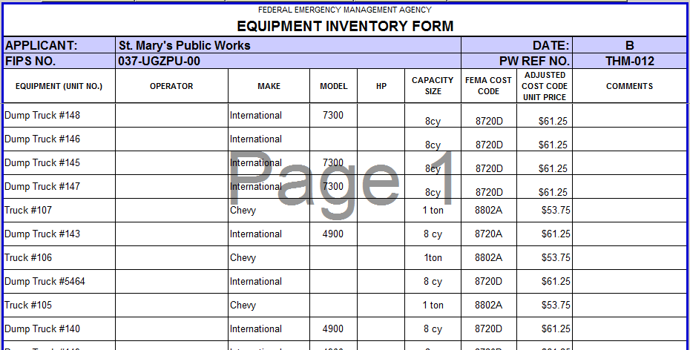
Equipment Inventory

Slide 15
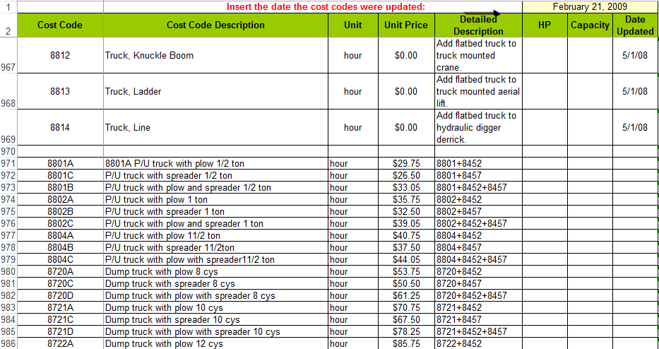
FEMA Cost Codes

Slide 16
Force Account Materials (purchased or stock)
Type
Invoices to support purchase (prior for stock items)
When, where, and how materials were used?
FOOD???

Slide 17
Force Account Materials (capture sheet)

Slide 18
Contracts
Must be necessary for recovery or to protect life & property
Can be standing or newly established
Must be reasonable
Must comply with Agency, State, and Federal procurement

Slide 19
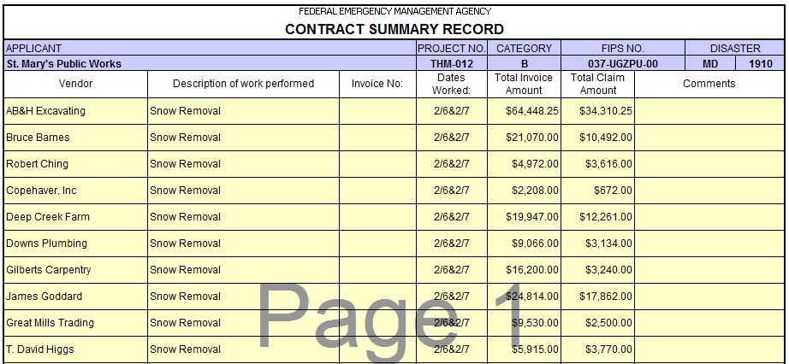
Contract Summary Record

Slide 20
Direct Administrative Costs
Must be directly associated with a particular project
Must be reasonable to compiling information
May include things - such as copies, office staff, etc.
Can include equipment, such as vehicles, for site visits

Slide 21
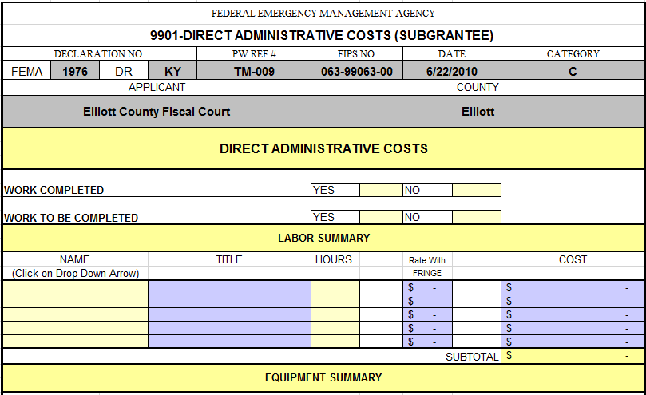
Direct Admin Costs

Slide 22
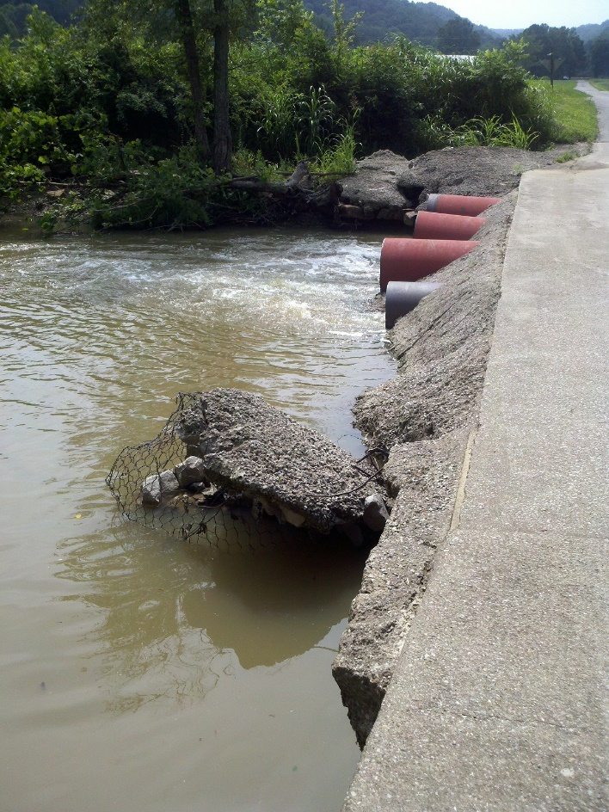
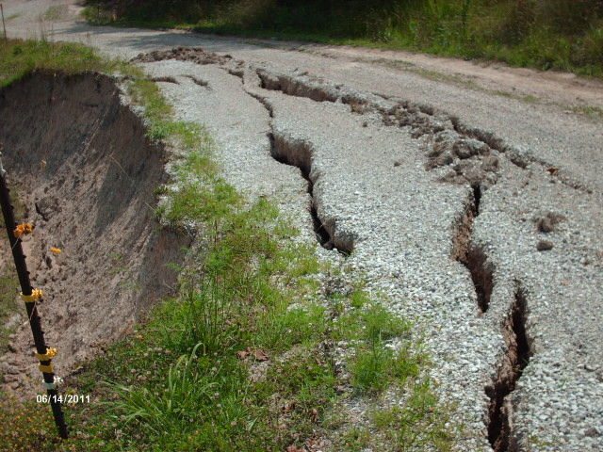
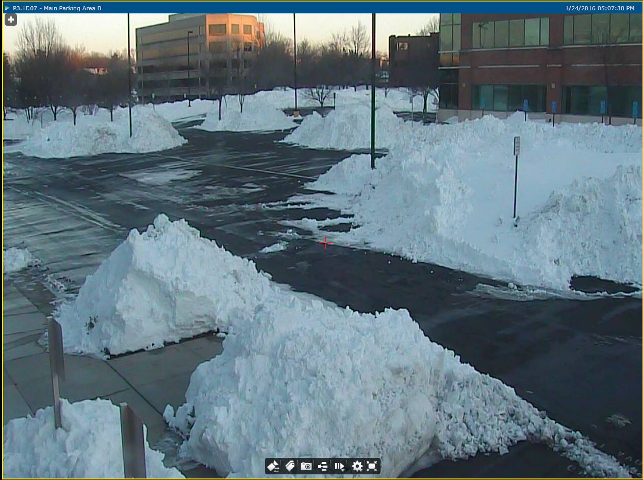
Photos
Photograph everything…..

Slide 23
So…How do I plan?
Have quick access to HR personnel. Train them on the information needed.
Have standing inventory lists of equipment within your jurisdiction…public works, road crews, physical facilities departments. Most use some form of numbering system.
Know what materials are commonly kept by these departments that may be used during a disaster.

Slide 24
Document, Document, Document
Keep records of everything. If your EOC is activated during an incident, be sure that you have someone in Finance & Admin that is tracking all of these items. Labor, equipment, materials and contracts form the basis of most disaster grant applications.
You can NEVER have enough documentation!

Slide 25
Close-out….(final adjustment)
FEMA uses a program called “close-out” to finalize all grants. Basically, this program is a double-check of all documents and costs associated with the grant.
Everything will be checked …… and checked again for accuracy. Any adjustments will be made at close-out and MAY result in returns of funds to FEMA (through the Commonwealth).

Slide 26
Recent Changes to FEMA “Projects”
After many years of development, FEMA recently moved to a more “modern” system for developing project worksheets. The old system was an Excel-based spreadsheet.
The information required has not changed, simply the format in which it is included in the project has changed.
If you use the “older” forms (such as those included in this presentation) to track your expenses, FEMA will be able to convert them into the new format.

Slide 27
Imagine when FEMA shows up for your sub-applicant briefing, and you have all of your information ready and available to them!
It is possible!
It just takes a bit of planning and knowledge to make the FEMA Public Assistance Program work for you and your Agency!

Slide 28
Does it make sense to apply??? Let’s see how the Northern Virginia Community College did after Winter Storm Jonas in 2016..

Slide 29
Winter Storm Jonas - NVCC
$123,478.00 covering 2,211 Force Account Labor hours (overtime only)
$37,155.33 covering 2,342 Force Account Equipment hours
$1,081.12 Materials used
$369,476.50 Contracts
$4,884.16 Direct Admin Costs (project development)
2 day cost reimbursement of roughly $536,000.00

